Slide 1
Charpy Impact Test
Charity Fischer

Slide 2
History
S. B. Russell devised the first pendulum fracture test in 1896
His initial tests were standardized by French scientist Georges Charpy in 1901 with notched samples
The test was crucial during WWII in understanding fracture issues in ships

Slide 3
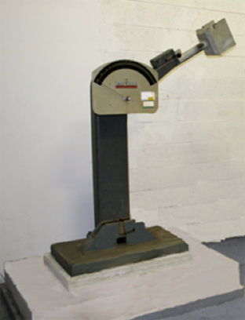
What it Does
Measures the strength of different material samples.
Helps in studying the temperature-dependent ductile to brittle transition.
Notes:
Ductile meaning pliable, flexible

Slide 4
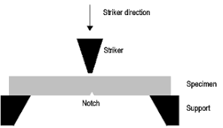
How it works
Each sample is standardized in size and shape and has a v-shaped notch which is centered on the machine so the notch faces away from the striker on the pendulum.

Slide 5
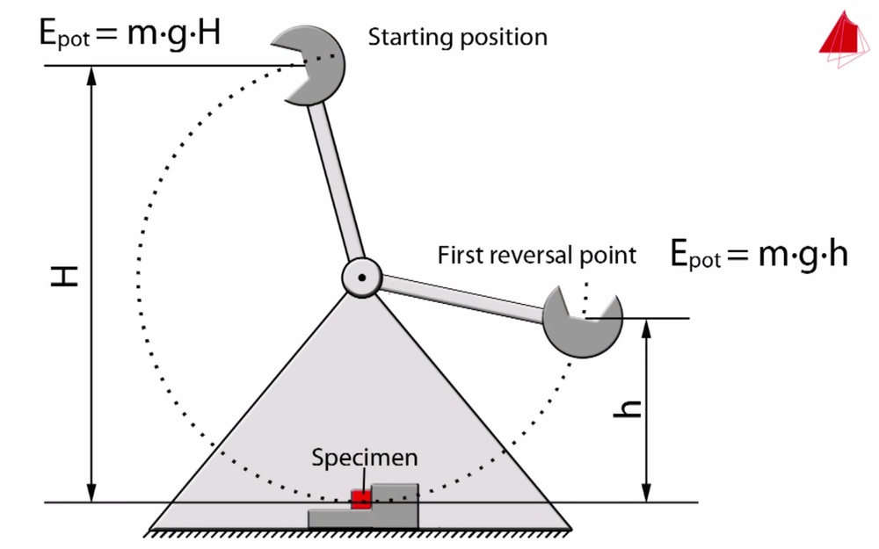
How it works
The pendulum is released and hits the sample which absorbs some of the force whose can be seen by the difference in height.
Notes:
A correctly adjusted meter will read 0 when there is no sample, but when a sample is hit it will absorb the energy giving it a different height and a different reading. Potential energy = mass x gravity x height

